Slide 1
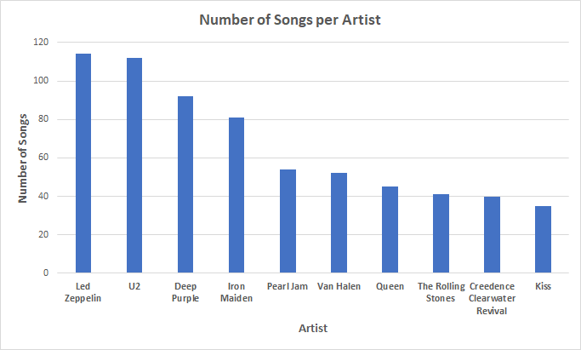
Which artist has more songs of the rock genre?
<visualization>
The bar graph shows the Top 10 artists with the most songs in the rock genre and number 1 is Led Zeppelin with 114 songs.

Slide 2
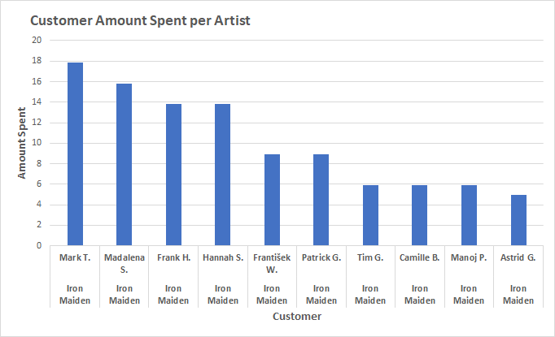
What Customer has spent the most dollars on the artist who has earned the most?
<visualization>
The number 1 selling artist is Iron Maiden and customer Mark Taylor has spent the most on music at the artist with $17.82.

Slide 3
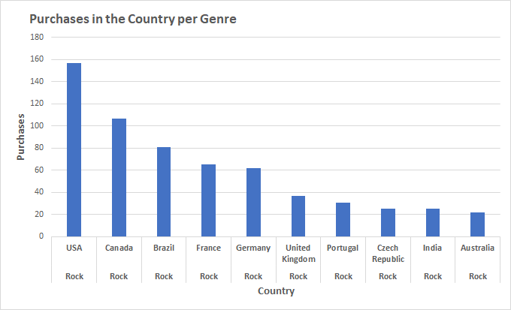
Which Genre has the most music in purchases each country?
<visualization>
Rock has the most popular music genre with 157 purchases in the USA. While I am only showing the top 10 here when I ran the query without a limit, both Rock and Alternative & Punk have 9 music purchases in Argentina.

Slide 4
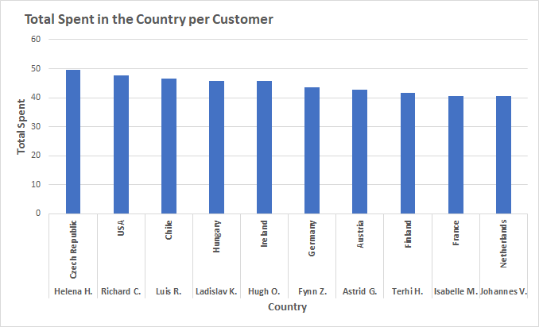
Which Customer has the most music dollars spent in each country?
<visualization>
Helena Holy has spent the most on music with $49.62 in the country Czech Republic. While I am only showing the top 10 here when I ran the query without a limit, Emma Jones and Phil Hughes both spent $37.62 on music in the United Kingdom.

